Slide 1



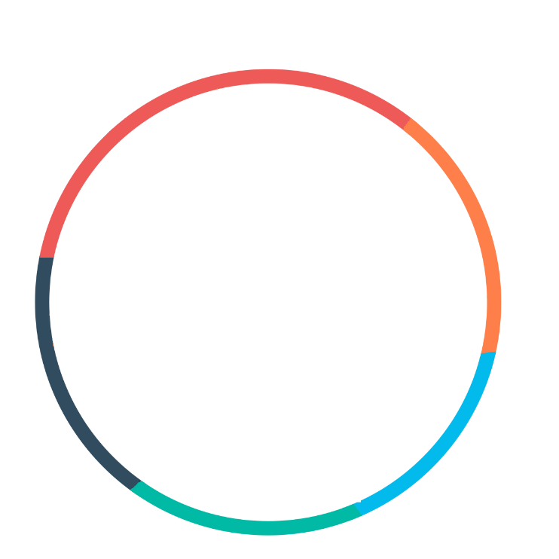





Badia Rtimi
Academic Education
FullStack js
Go My Code
2021
Process and Chemical
Engineer/FullStack web developer
Doctoral thesis
(Ecole Nationale d’Ingénieurs de Gabes :ENIG)
2018-Now
Chemical–Process Engineering
(Ecole Nationale d’Ingénieurs de Gabes :ENIG)
2015-2018
2-year selective physical-chemical preparatory classes leading to ENIG
(Institut Supérieur des Sciences Appliquées et de Technologie de Gabes :ISSAT)
ABOUT ME
2013-2015
I am basically a chemical and process engineer. I am passionate about new technologies that’s why I attended a training courses as a FullStack developer. fast learner looking for a professional opportunity
High school diploma in science plus university entrance
Taher el Hadded high school
2012-2013
Monsieur),
CONTACTS
phone: +21692691924
Accreditations and Certifications
Personal development center :
the Optimist
Participated in ISO 9001v 2015, ISO 14001v 2015 ,
OHSAS18001v 2015 standards formation
2016-2017
El hamma -Gabes 6020
rtimi.badiaa94@gmail.com
C++
Matlab
Word package
Work Experience
Skills
Chemical Group-Gabes
(GCT)
Project Graduation
- Calculate the mass flow rate of ammonia gas scrubbing system
-Excelled at ammonia gas scrubbing system simulation by using aspen- plus simulator
-Sizing a new ammonia gas scrubber system
Chemical Group-Gabes
(GCT) One month engineering placement
-Supervise the stages of sulfuric acid production
-Calculate the mass flow rate and the energy of frequent
Cement Society of Gabes
(SCG)
One month engineering placement
Participated in studying and optimizing of a bag filter
Chemical Group-Gabes
(GCT)
One month work placement
Took part in different fertilizers analyses
Arduino
03-2018/07-2018
Internet
Aspen plus Aspen Hysis
biginner
August 2017
Languages
German
beginner
French
(certified in diplôme d'études en langue française :DELF B2)
English
July 2017
Arabic
Mother tangue
Interests
July 2016
Reading
Fitness
VPRE JCI
Arduino trainer

